Slide 1
Static Scheduling of synchronous Dataflow Programs for Digital Signal Processing
Edward A. Lee
David G. Messerschmitt
IEEE Transaction on Computers
Vol C-36
Jan-1987
Nic Hollingum

Slide 2

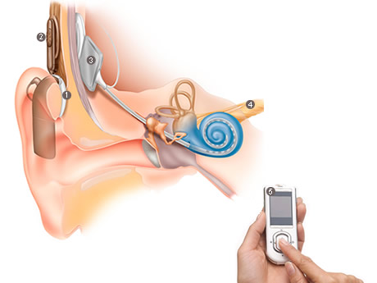
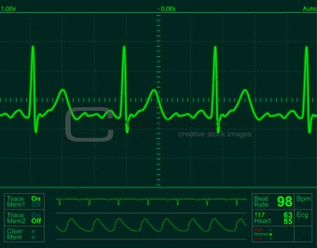



Impact

Slide 3
Results
Mathematical foundation for interpreting SDF graphs
  Relation to computation graphs [1]
  Conditions for validity/termination(or not)
  Semi-extensions: delays
Static scheduling
  Combinatorial (factorial) complexity
  Uses critical path estimation, Hu-Level [2] scheduling

Slide 4
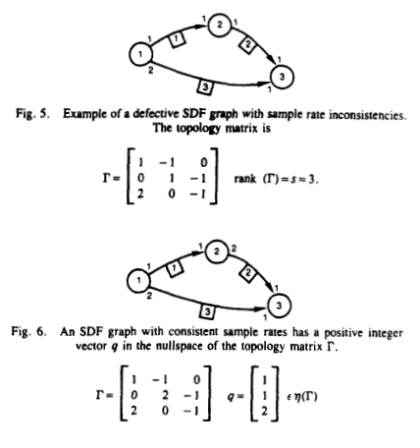
Results
Admissible graph:
  Fig 5: rate inconsistencies, all rows of topology matrix are linearly independent
  Fig 6: rate consistent, row 3 of topology matrix is sum of row 2 times row 1 plus row 2
Source: [0]: p28

Slide 5
Reflection
Very self contained, almost to the point of abstraction
Does not deal with extensions to the SDF framework (admittedly there were fewer at time of writing)
Does not deal with looping, paper assumes an no feedback
Good understanding of limitations of the model
Good discussion of optimality/feasibility of solutions

Slide 6
References
[0] E.A. Lee, D.G. Messerschmitt; “Static Scheduling of Synchronous Data Flow Programs for Digital Signal Processing”, IEEE Transaction on Computers, vC-36 – Jan 1987
[1] R.M. Karp, R.E. Miller; “Properties of a model for parallel computations: Determinacy, termination, queueing”, SIAM J: v14 – Nov 1966
[2] T.C. Hu; “Parallel sequencing and assembly line problems”, Operating Resources: vC-25 - 1961

Slide 7
Questions?
nhol8058@uni.sydney.edu.au

